Slide 1
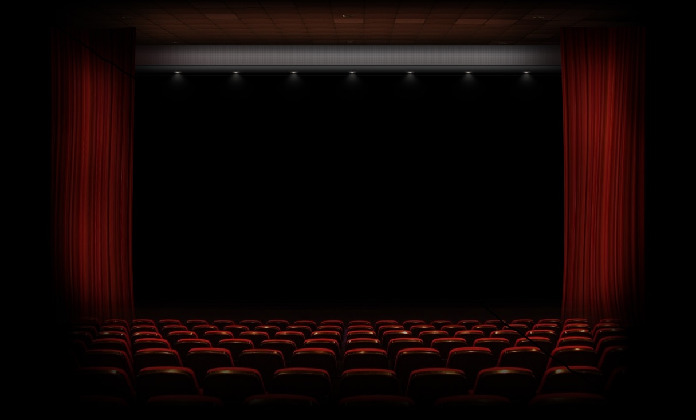
MOVIE RECOMMENDATION SYSTEM
PRESENTED BY:
MANAVI AGRAWAL
URVi PAREKH

Slide 2
CONTENTS
Introduction
Business Use-Cases
Scope
Business Benefits And End-User
Project Overview and Deployment
Future Work
Conclusion

Slide 3
Introduction
In Today’s world Machine Learning and Artificial Intelligence plays a great role in our day-to-day lives.
In n number of examples of Machine Learning and Artificial Intelligence examples Recommender System plays an important role now-a-days.
Recommender System are divided into two major parts :
Content Based Approach
Collaborative Based Approach
Examples : Movie Recommendation System , Job Recommendation System , Product-Based Recommendation System and many more.

Slide 4
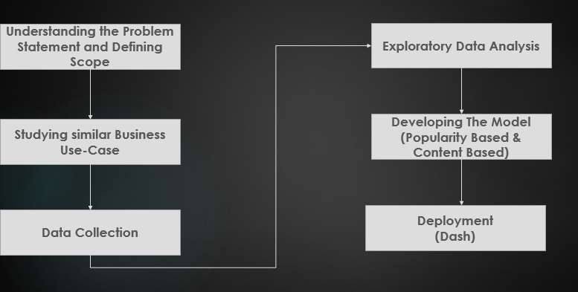
Project Pipeline

Slide 5
Business Cases
NETFLIX Use-Case
They recommend on the basis of :
The interactions with the service (such as viewing history and how we rated other titles),
other members with similar tastes and preferences on service,
information about the titles, such as their genre, categories, actors, release year, etc.
Also They catch the Information like :
the time of day we watch,
the devices we are watching Netflix on, and
how long we watch.

Slide 6
Business Cases
NETFLIX Use-Case
When we create our account into Netflix , they ask us to select few titles and know our interested movie.
If we don't select titles then they randomly just show us titles on the page.
And once we start watching movies and rating them they get the data and is inputted into their algorithms.
In addition to this they rank their title rows on the basis of 3 level personalization :
the choice of row (e.g. Continue Watching, Trending Now, Award-Winning Comedies, etc.)
which titles appear in the row, and
the ranking of those titles.

Slide 7
Business Cases
NETFLIX Use-Case
The most strongly recommended rows go to the top. The most strongly recommended titles start on the left of each row and go right -- unless you have selected Arabic or Hebrew as your language, in which case it will go right to left.
They don’t consider demographic information like age and gender.
They take feedback from the user from time to time and on the basis of that they try to improve their system.

Slide 8
Scope
Simple Movie Recommender System
Project Definition : We have tried to build the recommender System by using popularity based approach and content based approach.
Data Collected : Scraped from IMDB website.
Front-end : Dash
Back-end : SQLITE Database
Developed : Anaconda : Spyder

Slide 9
Business Benefits & End-User
Business Benefits
It is a basic recommendation system which can easily be adapted by any site/application which is related to the moves/series.
It gives personalized experience to the user which in tends increase the user’s interest towards the application.
Personalized experience attracts more users thus increasing the revenue of the company.
End-User
General Purpose use. Anyone can use it.

Slide 10
Project Overview
Data Collection
Source : IMDB WEB LINKS
Method : Web Scraping
Data Size : Around 2000 rows
Features : Title , Year , Genre , Director , Actor , Ratings , Votes
Data Stored : SQLite Database
Characteristics : The data collected consists of variation of movies like Bollywood , Hollywood , Chinese , TV Shows etc

Slide 11
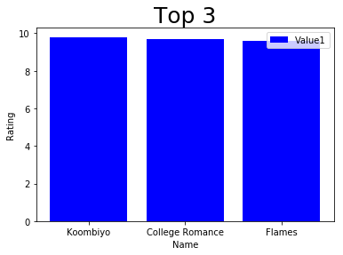
Project Overview
Exploratory Data Analysis

Slide 12
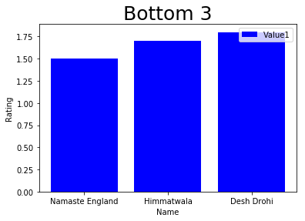
Project Overview
Exploratory Data Analysis

Slide 13
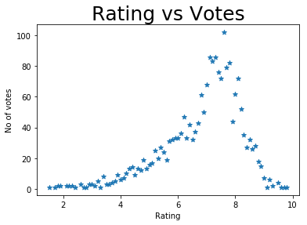
Project Overview
Exploratory Data Analysis

Slide 14
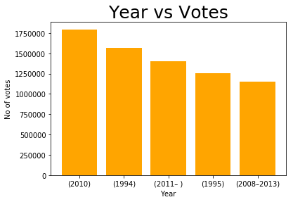
Project Overview
Exploratory Data Analysis

Slide 15
Project Overview
Model Building
First Approach :
Popularity Based Approach : In this approach on the basis of rating and votes the weighted average score is calculated and on that basis we get our most popular movies or we can get worst movies.
Second Approach :
Content Based Approach : In this approach on the basis of genre , director and actor the similar kind of movies are suggested to users.

Slide 16
Project Overview
Deployment
We have deployed the recommender system in Dash Ploty.
It is divided into 3 Parts :
Section 1 : Search Movies , Enter The Movie Name and gets its details and also view the similar kind of movies related to that movie on the basis of genre , director , actor.
Section 2 : Upcoming Movies , The upcoming movies are displayed and you can view trailers of it.
Section 3 : Popular Movies , The 10 most popular movies with their score is present in bar graph form.

Slide 17
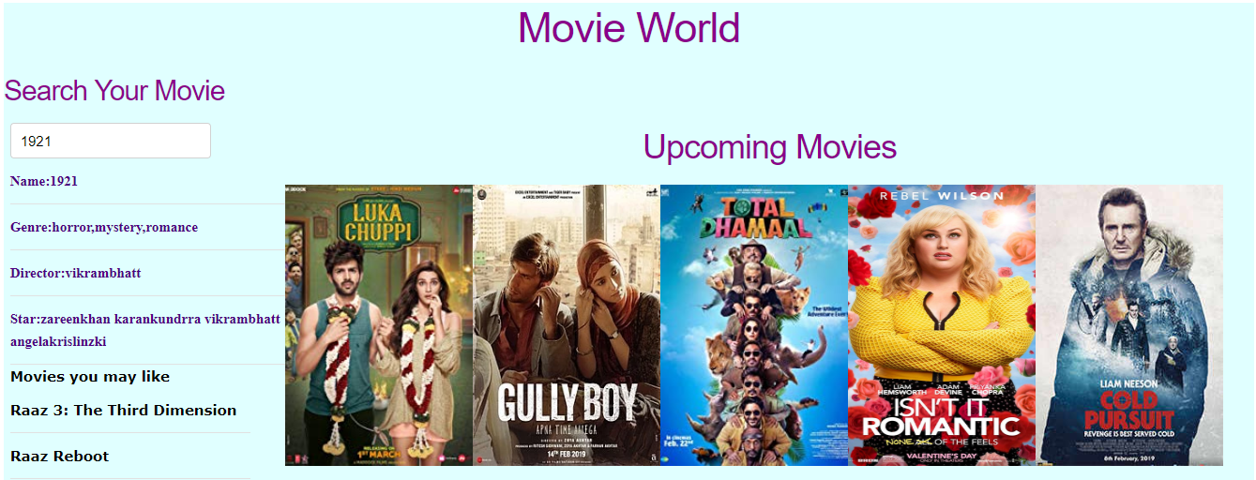
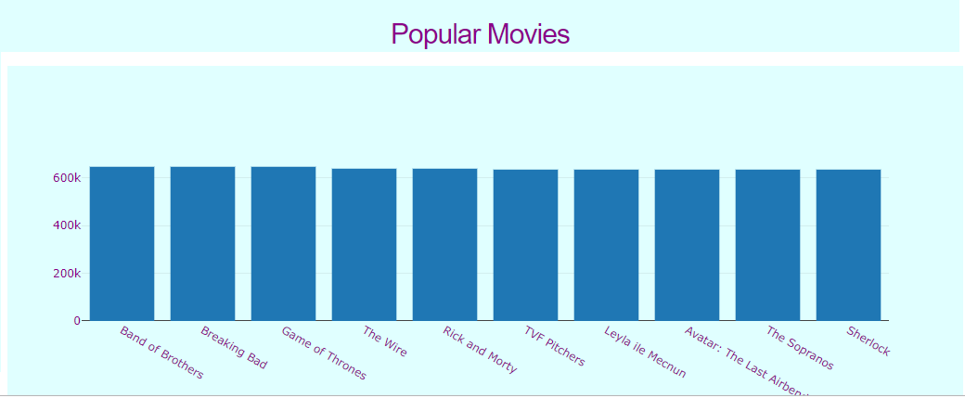
Project Overview
Deployment

Slide 18
Future Work
This can be made more user specific by creating the user profile.
There can be collaboration of content based and collaborative based approach and be more efficient.
The user log can be stored and useful insights can be derived from it.
More interactive User Interface can be built.
We can consider more features like plot description into account while building the recommended systems

Slide 19
Conclusion
To conclude , Its basic recommended system which recommends popular movies and similar kind of movies.

Slide 20
Thank You

